Slide 1

Agent Activity Chart
7/24/2023 6:29 AM
Print User : selenium.automation
Page 1 of 3

Slide 2
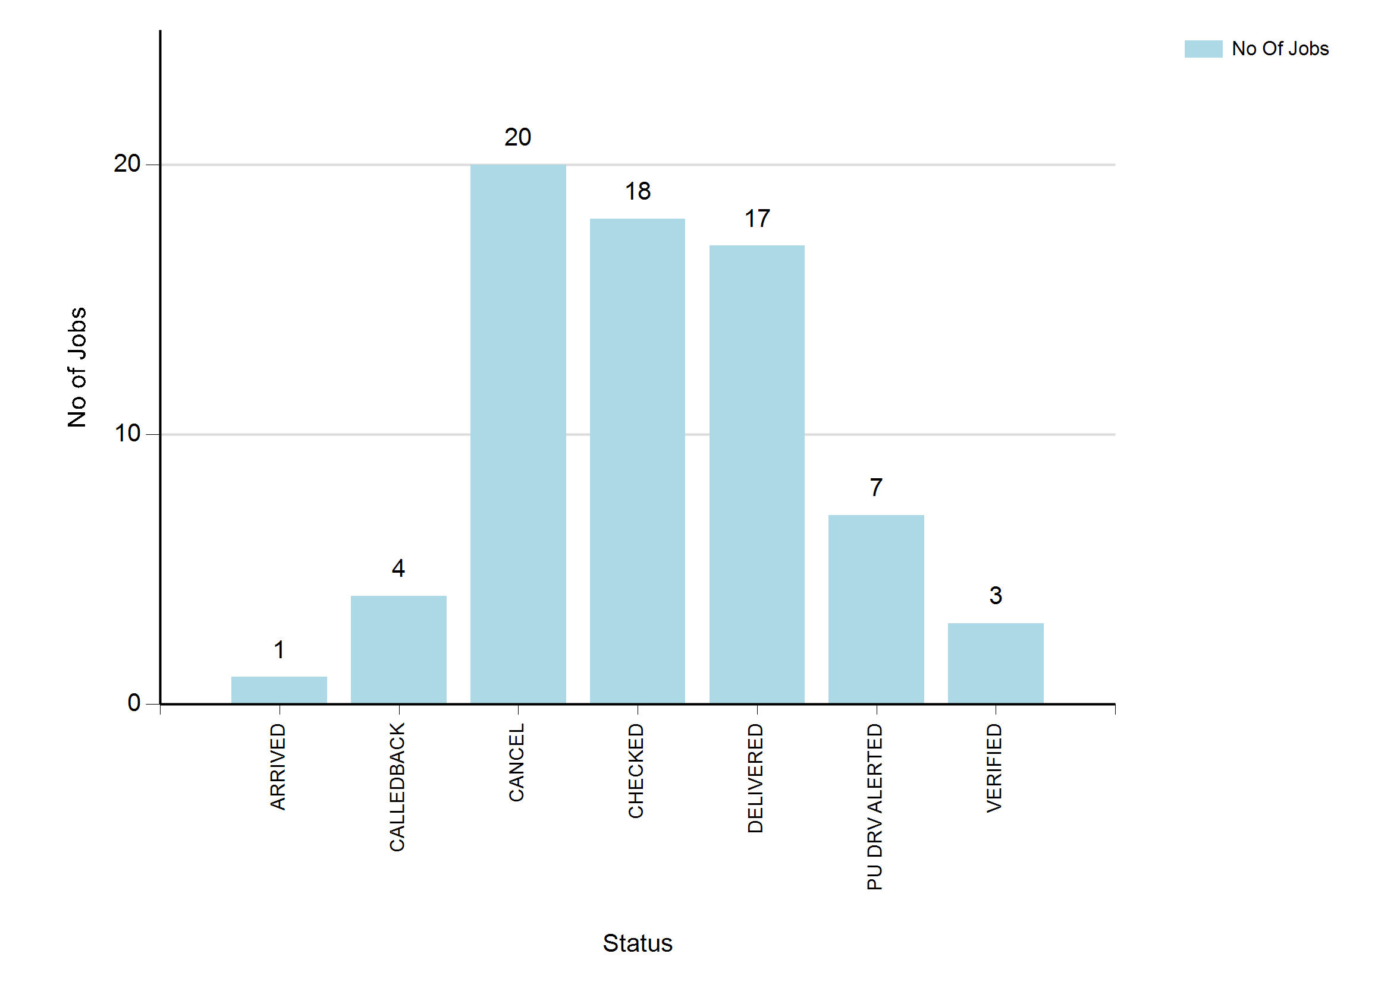
7/24/2023 6:29 AM
Print User : selenium.automation
Page 2 of 3

Slide 3
7/24/2023 6:29 AM
Print User : selenium.automation
Page 3 of 3

